Slide 1
Introduction to Psychology
Amna Nisar
Clinical Psychologist
Speech and language pathologist

Slide 2
Modern Psychological Perspectives
Amna Nisar
Clinical Psychologist
Speech and language pathologist

Slide 3
Modern psychological perspectives
Structuralism
Functionalism
Behaviorism
Psychoanalysis
Gestalt psychology
Cognitive psychology
Humanistic psychology
Biopsychosocial model

Slide 4
Structuralism
Proposed by Wilhelm Wundt and his student Edward Bradford Titchener.
Structuralism is the approach of psychology which emphasis on the study of components of consciousness.
It was believed that psychology was the science of conscious experience and that trained observers could accurately describe thoughts, feelings, and emotions through a process known as introspection.

Slide 5
Introspection
Introspection is the examination of one's own conscious thoughts and feelings.
In psychology, the process of introspection relies exclusively on observation of one's mental state, while in a spiritual context it may refer to the examination of one's soul.

Slide 6
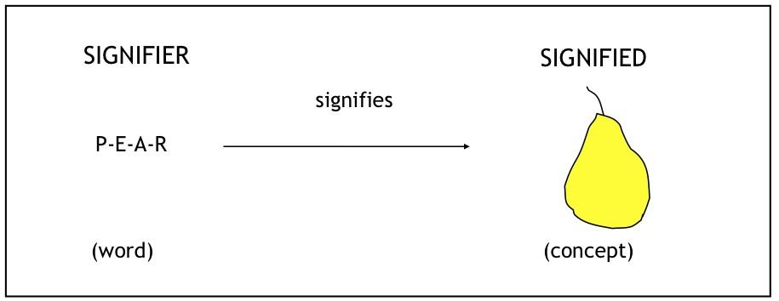
Example

Slide 7
Functionalism
Functionalism formed as a reaction to structuralism and was heavily influenced by the work of William James and the theory of evolution by Charles Darwin.
Rather than focusing on the elements of consciousness, functionalists focused on the purpose of consciousness and behavior.

Slide 8
Functionalism also focused upon the way human adapt to their environment their role and behavior played an important role to be better to environment.
This school of thought examined the ways in which behavior allows people to satisfy with their needs.

Slide 9
Behaviorism
Behavior is vital
Behaviorism argues that there is no mind, no thoughts, no feelings and the only important thing to consider is behavior
Ivan Pavlov
Edward Thorndike
John B Watson
B F Skinner

Slide 10
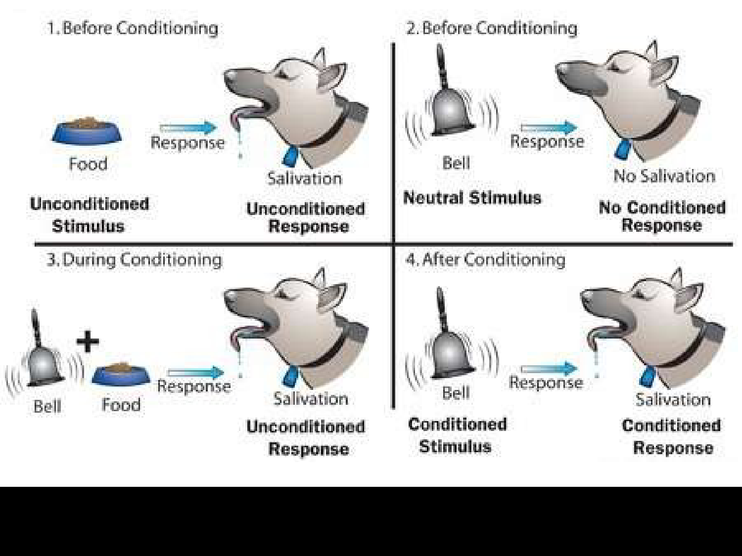
Ivan Pavlov (Classical conditioning)

Slide 11
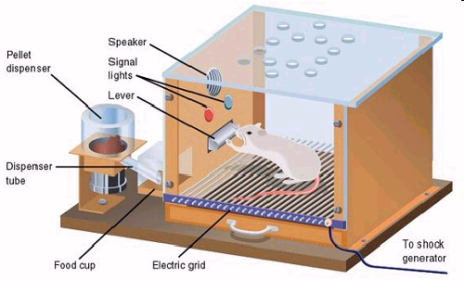
B F Skinner
Reinforcement and punishment

Slide 12
Gestalt
Gestalt is a German word that means roughly means “shape”, “form”, “essence”, or “whole”.
Gestalt is a psychology term which means "unified whole".
It refers to theories of visual perception developed by German psychologists in the 1920s
One of the most important theories of perception is the Gestalt Theory.

Slide 13


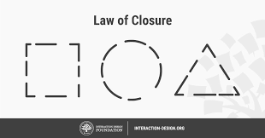

Gestalt Theory
“The Whole is different from the sum of its part”.
It was developed about 1910 by Max Wertheimer and carry on by Wolfgang Kohler and Kurt Koffka.

Slide 14
Humanistic psychology
Humanistic psychology emphasizes looking at the whole individual and stresses concepts such as free will, self-efficacy, and self-actualization. Rather than concentrating on dysfunction, humanistic psychology strives to help people fulfill their potential and maximize their well-being.

Slide 15
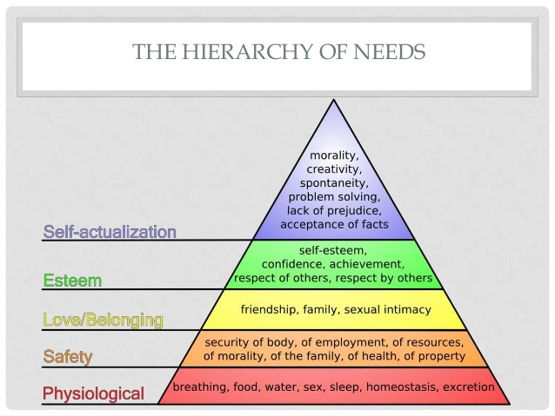
Maslow’s hierarchy of need

Slide 16
Cognitive psychology
Studies mental processes including how people think, perceive, remember and learn. As part of the larger field of cognitive science, this branch of psychology is related to other disciplines including neuroscience, philosophy, and linguistics.

Slide 17
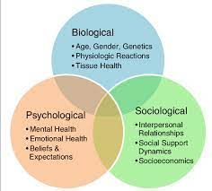
Biopsychosocial model

Slide 18
SCOPE OF PSYCHOLOGY

Slide 19
FIELDS OF PSYCHOLOGY
Experimental Psychology:
a general title applied to a variety of psychologists who are trained in designing and conducting research in specific basic areas like learning, sensation and perception, human performance, and motivation and emotion. A research oriented doctoral degree (Ph.D.) is usually needed.

Slide 20
2. Biopsychology:
Take a comparative and genetic perspective in the experimental analysis of basic psychological processes as they relate to the many ways in which animal species adapt, survive, reproduce and evolve.
3. Developmental Psychology:
Concerned with growth and development from conception till death. All aspects of the animal or human organism (physiological, biological, physical, cognitive, emotional, social, cultural) may be studied.

Slide 21
4. Social Psychology:
study the ways in which the social context affects the behavior of the individual and groups in the real world and the laboratory. Social psychologists focus on topics such as social roles, attitude formation and change, affiliation, interpersonal attraction and interaction, conformity, and group processes.

Slide 22
5. Industrial / Organizational Psychologists:
Study the relation between individuals and work. They are employed in business and industry, in government, and in colleges and universities, and may perform a variety of jobs. An industrial/organizational psychologist working in industry may study how work is organized; suggest changes to improve the satisfaction of employees, the quality of the organization's services, and productivity; consult with management on the development of effective training programs for employees; design programs for the early identification of management potential; administer career counseling and pre retirement counseling programs; develop affirmative action programs; recommend changes in job definition; design a system of performance evaluation.

Slide 23
6. Educational Psychologists:
Are concerned with a range of activities from initial design through development and evaluation of both materials and procedures for education and training. Such positions exist in public schools, in the military, in private research and development companies, and in industrial concerns. They may deal with analyzing education and training needs, with developing materials for instruction in various media, with designing the best conditions for instruction, and with evaluating the effectiveness of instructional programs.

Slide 24
7. Clinical Psychology:
We are concerned with the diagnosis and treatment of psychological disturbances. Their responsibilities range from administering and scoring psychological tests, to engaging in therapy, to supervising the training of graduate students in the delivery of mental health services, to administering a community mental health program. Some clinical psychologists obtain faculty positions in a college or university some serve as consultants or as therapists.

Slide 25
8. Counseling Psychology:
We are concerned with counseling, teaching, consulting research, and/or administration. In this we are particularly concerned with the role of education and work in an individual's functioning, and with the interaction between individuals and the environments in which they live. Typically, counseling psychologists work with normal or moderately maladjusted persons, individually or in groups. This work includes use of traditional counseling interview methods, interest, ability and personality tests, and educational and occupational information.

Slide 26
9. Cross-cultural psychology
Is a branch of psychology that looks at how cultural factors influence human behavior. They study whether behavior is culture-universal or culture-specific.
10. Forensic Psychology:
It is defined as an intersection between psychology and the criminal justice system. Forensic psychologist work in legal area assisting in jury selection, evaluating disability claims. and providing expert testimony during court trials.

Slide 27
11. Environmental psychology:
Is an interdisciplinary field focused on the interplay between humans and their surroundings. The field defines the term environment very broadly including all that is natural on the planet as well as social settings, built environments, learning environments and informational environments.
12. Psychiatry:
Psychiatry is a branch of medicine practiced by physicians with an M.D degree who specialize in abnormal psychology and therapy. The difference between clinical psychologist and psychiatrist is they can prescribe medicines, whereas clinical psychologist cannot.

Slide 28
Always be thankful

Slide 29
Thank You

